Slide 1
Intro to Design Patterns
Lecture 5.2 – Abstract Factory Pattern

Slide 2
Reading
DPE
Chapter 11 – The Abstract Factory Pattern

Slide 3
If the Families are varying use the Abstract Factory pattern
Technique
Static method that returns a concrete factory of type abstract
Abstract methods to create the right kind of dependent objects
1 Factory hierarchy, N dependent object hierarchies
Benefits
Decouples the using logic from the instantiation logic

Slide 4
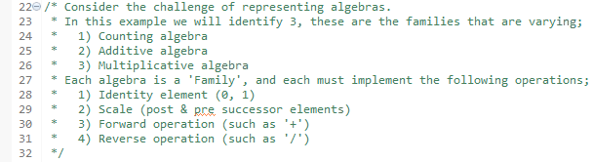
Solution Example - Specs

Slide 5
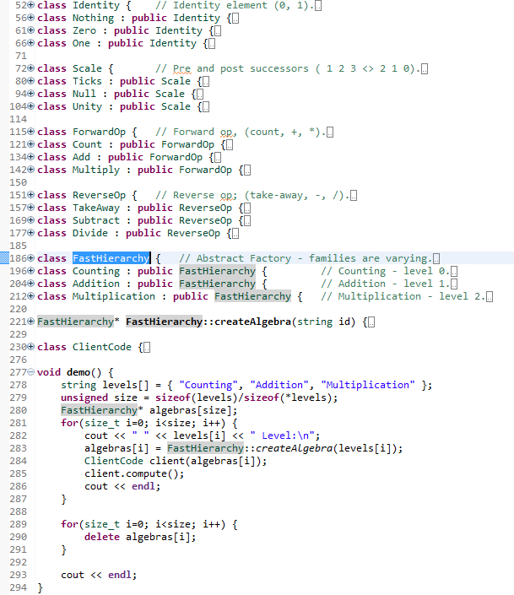
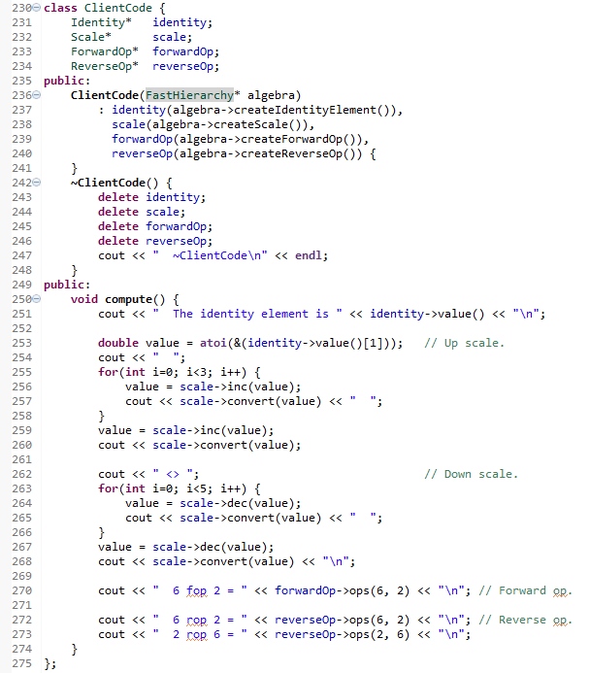

Slide 6
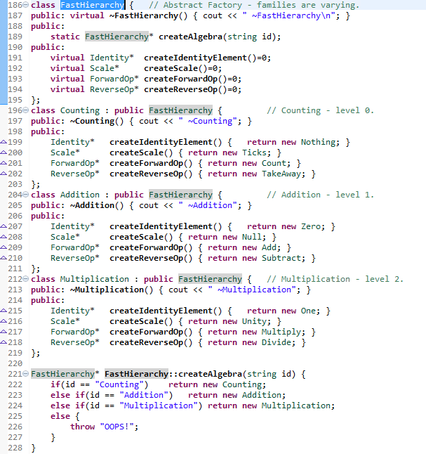
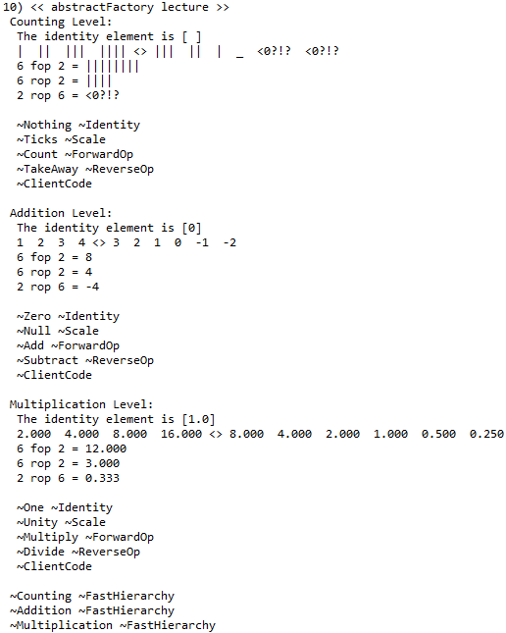
Factory Hierarchy (the Families)

Slide 7
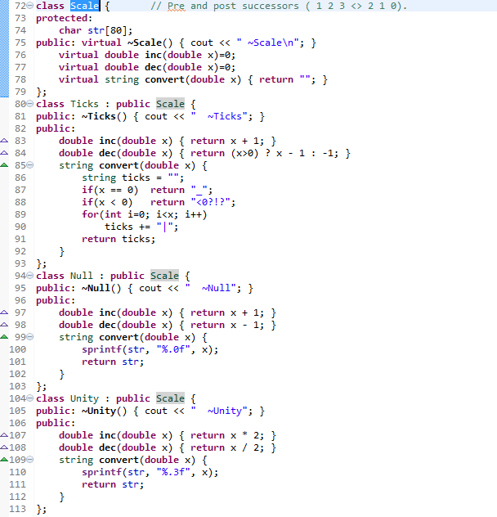
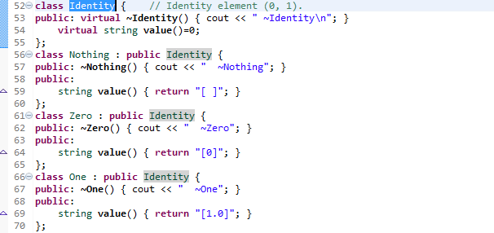
Solution Example

Slide 8
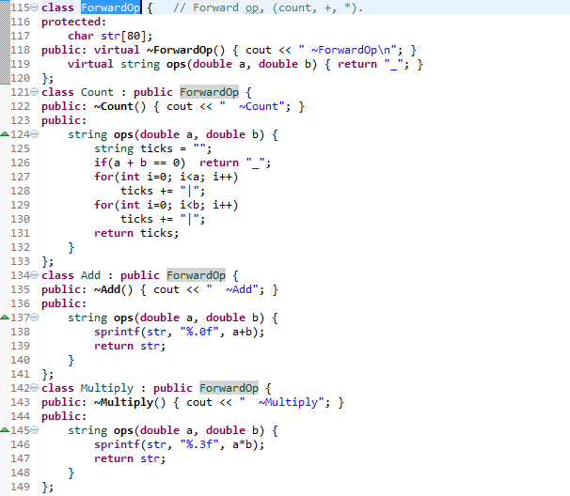
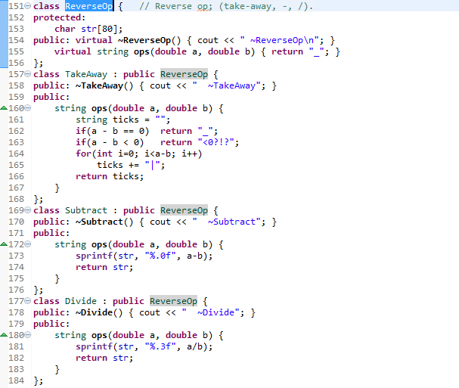
Solution Example

Slide 9
Output
Client instantiated 3 times, once for each ‘Family’
Runs through the 4 operations each family should support
Note the dtor sequences
Cleanup objects in each family
Cleanup the factories
Notes:
Note how the dtor unwinds the objects.

Slide 10
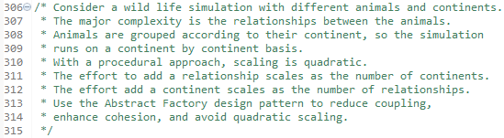
Homework

Slide 11
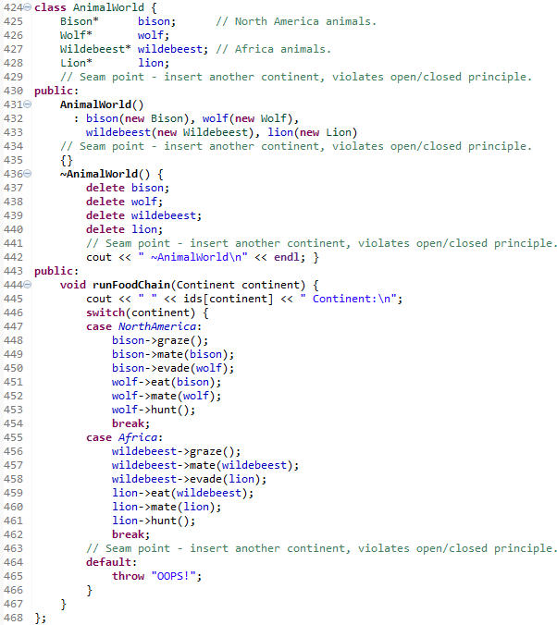
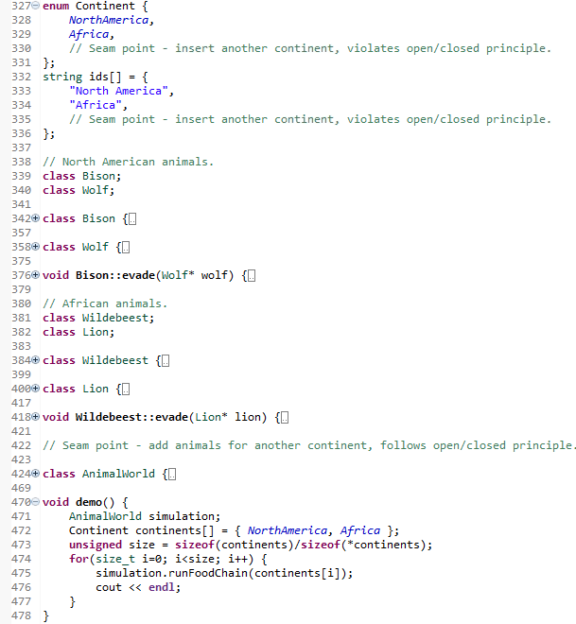
P

Slide 12
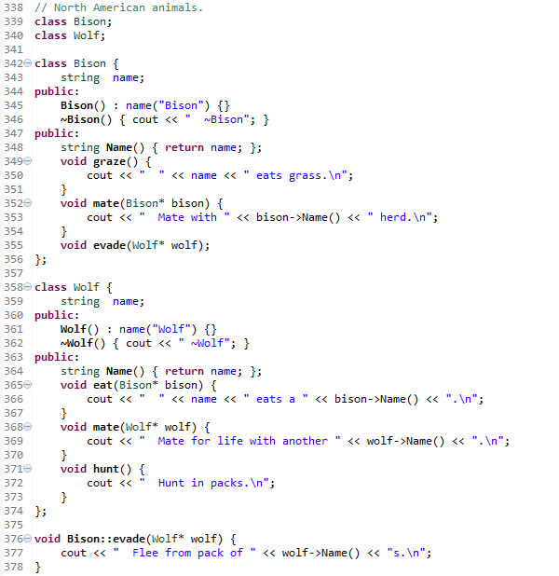
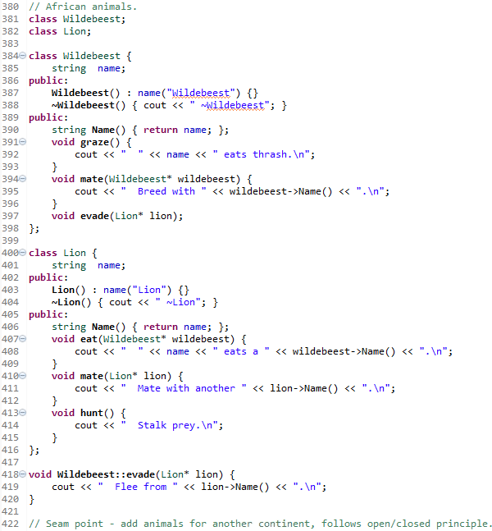
Problem

Slide 13
Summary
When the families are varying, use the Abstract Factory pattern to encapsulate the variation.
Use the polymorphic factory object to create a set of entities that work together in concert.
Use when the relationships between entities in different families are constant and large or complicated.

Slide 14
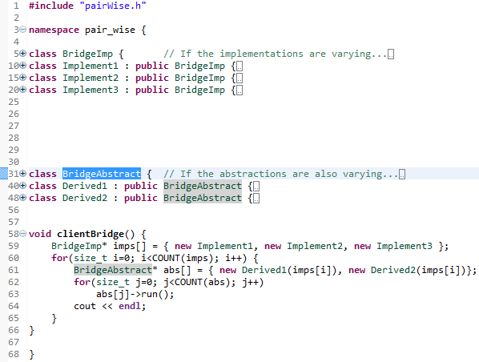
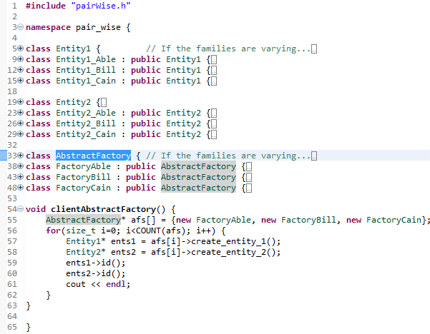
Pair Wise Comparison

Slide 15
Class Progress
If the algorithms are varying
If the interfaces are varying
If the API’s are varying
If the steps are varying
If the classes are varying
If the options are varying
If the listeners are varying
If the responders are varying
If abstract’n & implement’n vary
If the families are varying
Use the Strategy pattern
Use the Adapter pattern
Use the Facade pattern
Use the Template Method pattern
Use the Factory Method pattern
Use the Decorator pattern
Use the Observer pattern
Use Chain of Responsibility pattern
Use the Bridge pattern
Use the Abstract Factory pattern

Slide 16
Backup Slides

Slide 17
